Slide 1
Design of Pattern Matching Algorithms
Naïve Algorithm – Brute Force Algorithm

Slide 2
String Searching/Matching Problem
The objective of string searching is to find the location of a specific text pattern within a larger body of text (e.g., a sentence, a paragraph, a book, etc.).
Example: Find match of “aba” in given text “abcbaba”.
As with most algorithms, the main considerations for string searching are speed and efficiency.
There are a number of string pattern matching algorithms in existence today, most common are Brute Force algorithm, Knuth Morris Pattern (KMP) algorithm and Boyer Moore algorithm.

Slide 3
Brute Force Algorithm
i) It is the simplest method which uses brute force approach.
ii) It is a straight-forward approach of solving the problem.
iii) It compares first character of pattern with searchable text. If match is found, pointers in both strings are advanced. If match not found, pointer of text is incremented and pointer of pattern is reset. This process is repeated until the end of the text.
iv) It does not require any pre-processing. It directly starts comparing both strings character by character.
v) Also known as “Naïve Algorithm” of Pattern Matching.

Slide 4
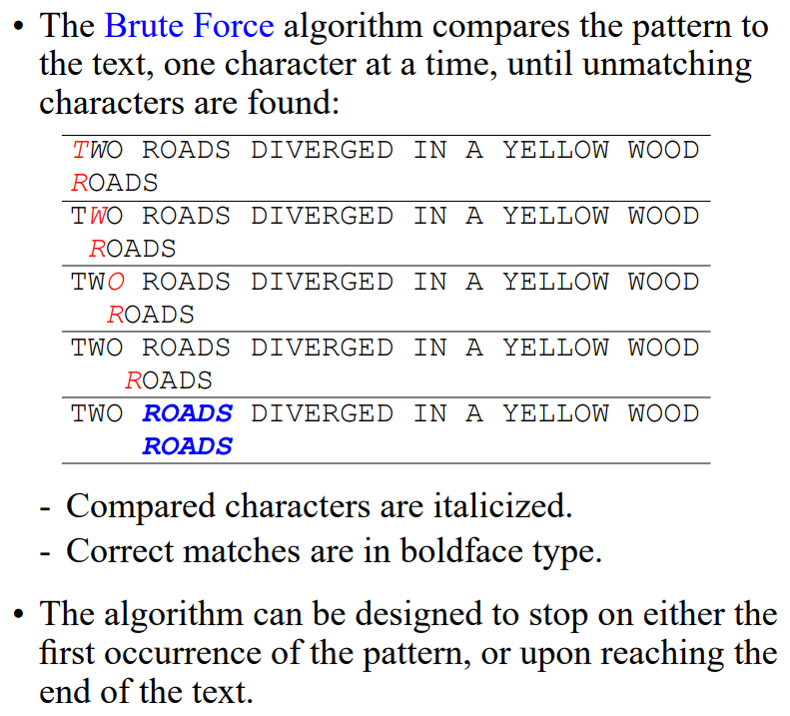
Brute Force Algorithm

Slide 5
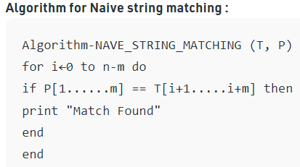
Brute Force Algorithm
Given a text of length N txt[0..N-1] and a pattern of length M pat[0..M-1], write a function search(char pat[], char txt[]) that prints occurrence of pat[] in txt[]. You may assume that N > M.

Slide 6
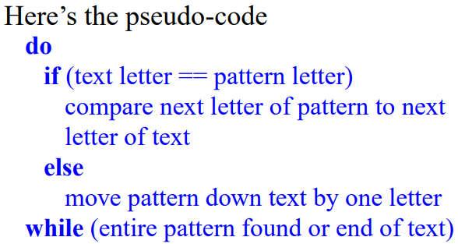
Brute Force Pseudo Code

Slide 7
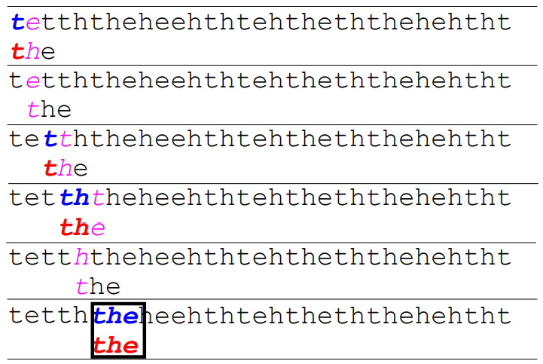
Brute Force Pseudo Code
Example:

Slide 8
Brute Force Implementation
#include <stdio.h>
#include <string.h>
void search(char* pat, char* txt)
{
int M = strlen(pat);
int N = strlen(txt);
/* A loop to slide pat[] one by one */
for (int i = 0; i <= N - M; i++) {
int j;
/* For current index i, check for pattern match */
for (j = 0; j < M; j++)
if (txt[i + j] != pat[j])
break;
if (j== M) { // if pat[0...M-1] = txt[i, i+1, ...i+M-1]
printf("Pattern found at index %d \n", i);
break;
}
}
}

Slide 9
Brute Force Implementation Cont...
int main()
{
char txt[] = "AABBACAADAABAAABAA";
char pat[] = "AABA";
// Function call
search(pat, txt);
return 0;
}
Output:
Pattern found at index 9

Slide 10
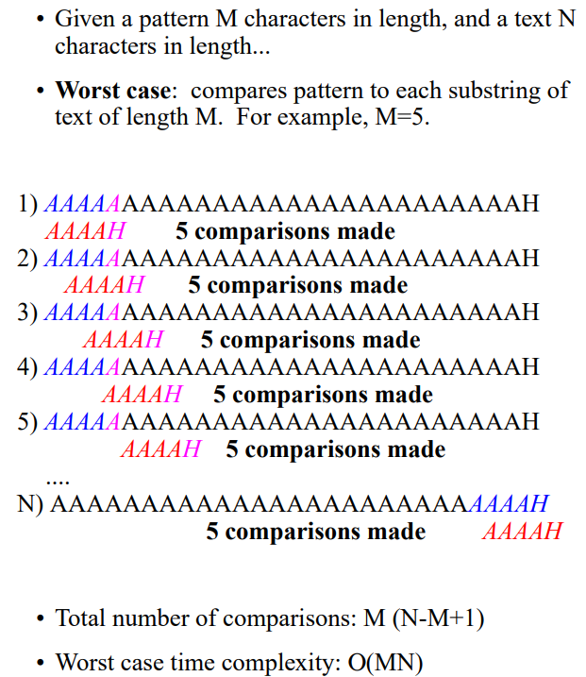
Brute Force Complexity (Worst Case)
Worst case also occurs when only the last character is different.

Slide 11
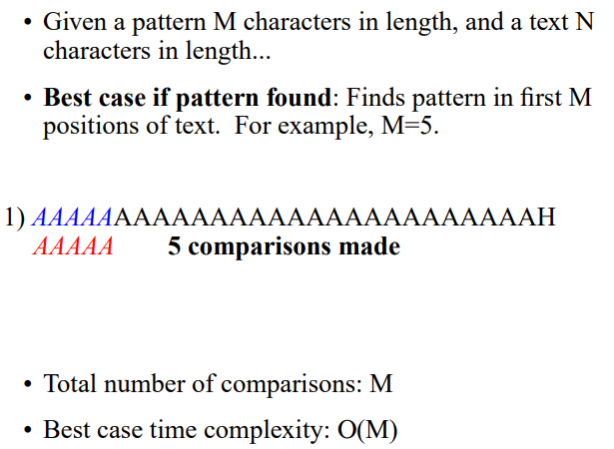
Brute Force Complexity (Best Case)
Best case occurs when pattern is present in starting M characters in text.

Slide 12
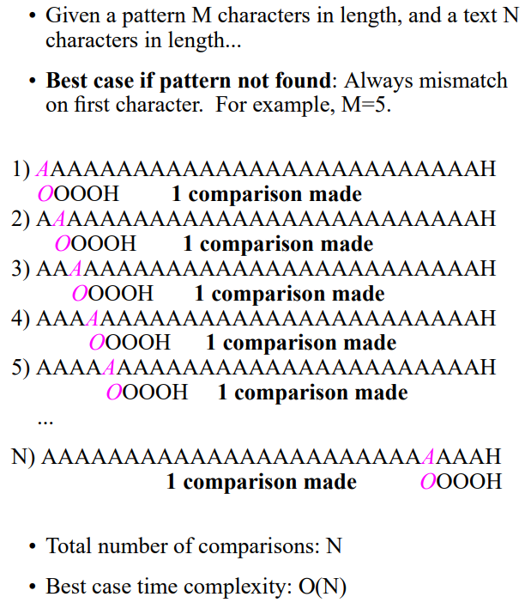
Brute Force Complexity (Best Case)
Best case also occurs when the first character of the pattern is not present in the text at all.

